Slide 1
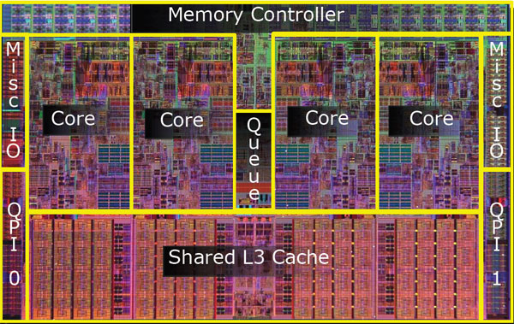
EECE 528
Multicore Memory System (Snooping)
Instructor: Dr. Guy Lemieux
lemieux@ece.ubc.ca
(many slides courtesy of Prof. Tor Aamodt)

Slide 2
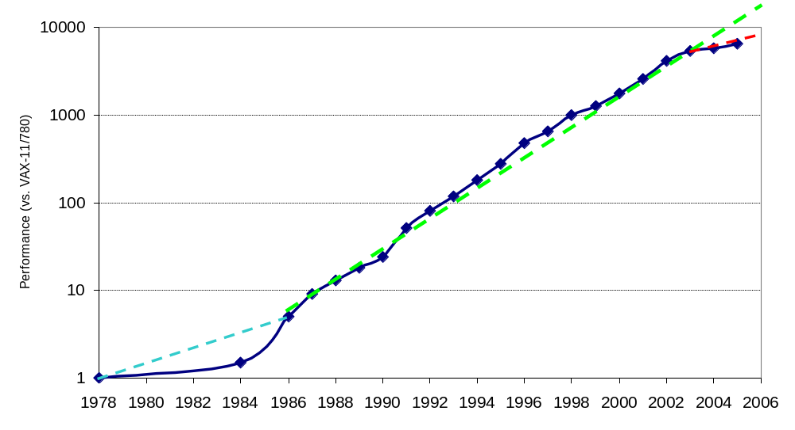
Uniprocessor Performance
3X
Concern about end of Moore’s Law… Lots of interest in Multiprocessors.

Slide 3
Typical Multiprocessor
Each P_{i} is a processor.
“$” is common short form for “cache” (because cache sounds like “cash”).
In today’s systems multiple processors are integrated into a single chip and referred to as “cores”.
A key feature of a multiprocessor is the processors are connected together via some sort of interconnection network (which may be a bus, crossbar, ring, mesh or some other topology).
P
P
1
n
$
$
Inter
connection network
Cache
Memory (DRAM)

Slide 4
How a programmer uses this?
Multiprogramming
  Separate single thread applications
  Benefit: no “sequential” term in Amdahl’s Law
Parallel programming APIs / Languages
  APIs: Pthreads, OpenMP, MPI
  Languages: CUDA, OpenCL, High Performance Fortran, Erlang, Sisal
Parallelizing Compiler
  Takes C/C++/Fortran and generates parallel program

Slide 5
Example pthreads Program
#define N (1024*1024)
double data[N], sum[2];
void *thread_0() { int i; for(i=0;i<N/2;i++) sum[0] += data[i]; }
void *thread_1() { int i; for(i=0;i<N/2;i++) sum[1] += data[i+N/2]; }
int main(int argc, char *argv[])
{
pthread_t t0, t1;
// load data with values here...
pthread_create(&t0, NULL, thread_0, NULL);
pthread_create(&t1, NULL, thread_1, NULL);
pthread_join(t0, NULL);
pthread_join(t1, NULL);
double total = sum[0]+sum[1];
// do something with total here
return 0;
}
creates a thread
that starts running
code in thread_0.
main()
thread_0()
thread_1()
Create two threads. Operating system can schedule them on different cores so they run concurrently.

Slide 6
thread_0()
thread_1()
P
P
1
n
$
$
Inter
connection network
Cache
Memory (DRAM)

Slide 7
Hardware Multithreading
Observation: Superscalar processors that support multiple issue seldom sustain peak instructions per cycle.
Why? Data dependencies, long memory access latencies, branch mispredictions, …

Slide 8
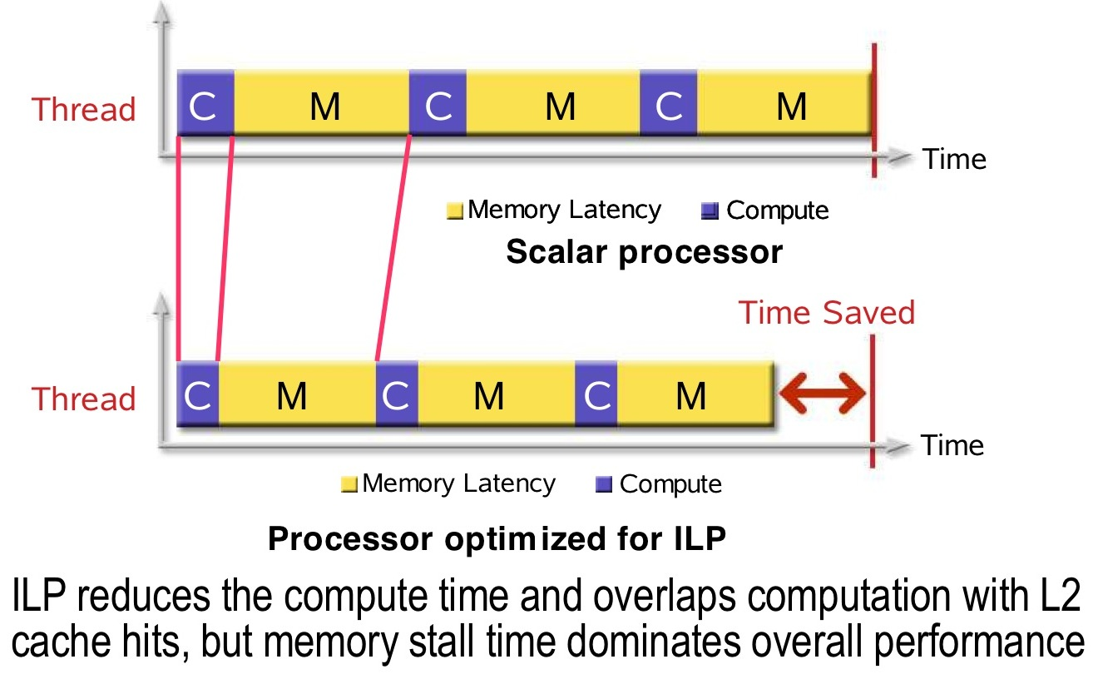
Hardware Idle Due to Memory Latency

Slide 9
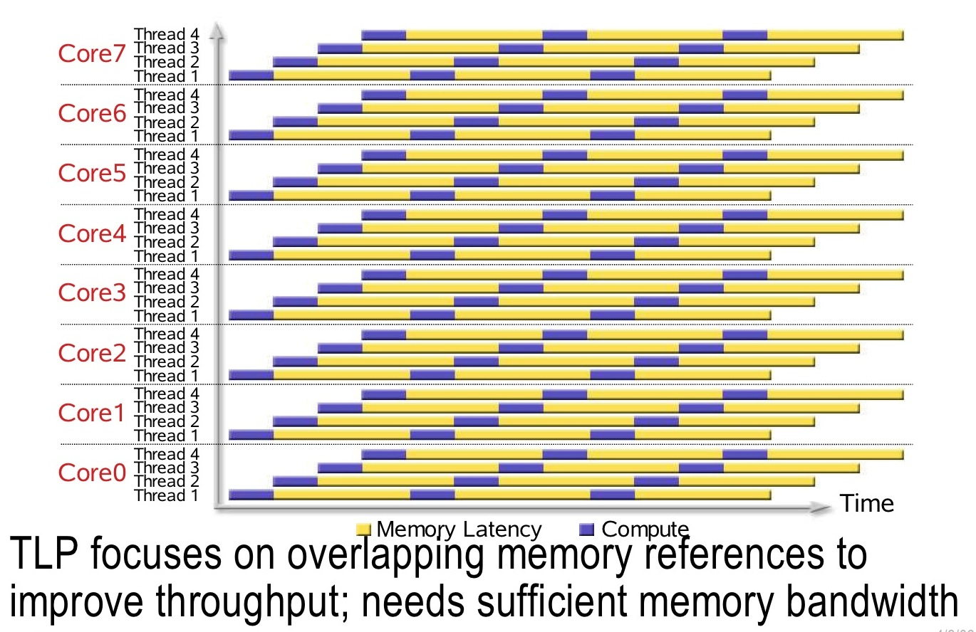
Fine-Grained Multithreading

Slide 10
Simultaneous Multithreading
Superscalar Coarse Grained Fine Grained Simultaneous
=pipelining+ Multithreading Multithreading Multithreading
multiple issue+ (CGMT) (FGMT) (SMT)
Tomasulo+ROB+ Uniprocessor w/ Ex. GPUs, Intel
BTB+BP Virtual Memory Sun Niagara “Hyperthreading”
Time
Issue Slots
<number> of 19

Slide 11
Parallel Communication Models
Communication occurs by explicitly passing messages among the processors:
message-passing multiprocessors
Communication occurs through a shared address space (via load and store instructions):
shared memory multiprocessors
  UMA (Uniform Memory Access time)
  NUMA (Non Uniform Memory Access time multiprocessor)

Slide 12
Shared Memory Multiprocessors
We will focus on shared memory multiprocessors.
Communication occurs via memory—from earlier example:
thread_0() writes sum[0]
thread_1() writes sum[1]
main() reads sum[0] and sum[1] and adds them.

Slide 13
Intuitive “Memory Model”
P
L1
Reading an address should return the “last value written to that address”
100:67
L2
100:35
Memory
Disk
100:34
Two subtle but important issues in practice:
Coherence defines behavior of accesses to same location – problem caused by using caches to improve performance.
Consistency defines behavior of accesses to different locations – problem caused by allowing parallelism in processing memory requests.

Slide 14
Caches Critical for Performance
Reduce average latency
Reduce average bandwidth
Data is logically transferred from producer to consumer via memory
  store reg --> mem
  load reg <-- mem
P
P
P
Many processors can share data efficiently
Problem: What happens when store & load are executed on different processors?

Slide 15
“Processor-Centric” Perspective
1
0
0
1
0
0
S
y
n
c
h
r
o
n
i
z
a
t
i
o
n
D
a
t
a
-
r
e
m
o
t
e
D
a
t
a
-
l
o
c
a
l
7
5
7
5
B
u
s
y
-
o
v
e
r
h
e
a
d
B
u
s
y
-
u
s
e
f
u
l
)
)
s
s
(
(
e
e
m
5
0
m
5
0
i
i
T
T
2
5
2
5
P
0
P
1
P
2
P
3
(
a
)
S
e
q
u
e
n
t
i
a
l
(
b
)
P
a
r
a
l
l
e
l
w
i
t
h
f
o
u
r
p
r
o
c
e
s
s
o
r
s

Slide 16
Cache Coherence Problem
P
1
P
2
P
3
u
= ?
u
= ?
3
$
4
$
5
$
u
:5
u
:5
u
= 7
1
I/O devices
u
:5
2
Memory
  Processors see different values for u after event 3
  With write back caches
    Value written back to memory depends on order of which CPU cache writes back value first
  Unacceptable situation for programmers

Slide 17
Defining Coherent Memory System
Preserve Program Order:
  Time t1: P1 writes 1 to X
  Time t2: P1 repeatedly reads X ⬅ P1 will always read value 1
  (assuming no writes to X by another processor occurs in between)
Coherent view of memory:
  Time t1: P1 writes 1 to X
  Time t2: P2 repeatedly reads X ⬅ P2 will eventually see value 1
  Once new value is seen by P2, the old value will never be seen again
  (assuming no other writes to X by another processor occurs in between)
Write serialization:
  Time t1: P1 writes 1 to X
  Time t1’: P2 writes 2 to X
  There may be a race, t1 < t1’ or t1’ < t1.
  Time t2: Pn repeatedly reads X ⬅ All processors will see same race outcome
  ie, all processors will see the same result, (eg, 1 followed by 2)

Slide 18
Migration and Replication
Parallel program with “threads” running on multiple processors will normally have copies of the same data in several caches. This helps performance by keeping data close to where it is being used currently.
Migration - Data moved to cache and used there (reduce latency). Cache block can move from one processor to another if being modified by several processors.
Replication - If data read by multiple processors all have local copy.
Goal in both cases is to reduce latency to access data and bandwidth consumed on interconnect and in access to memory.

Slide 19
Classes of Cache Coherence Protocols
Directory based — Sharing status of a block of physical memory is kept in just one location, the directory
Snooping — Every cache with a copy of data also has a copy of sharing status of block, but no centralized state is kept
  All caches are accessible via some broadcast medium (e.g., a bus)
  All cache controllers monitor or snoop on the medium to determine whether or not they have a copy of a block that is requested

Slide 20
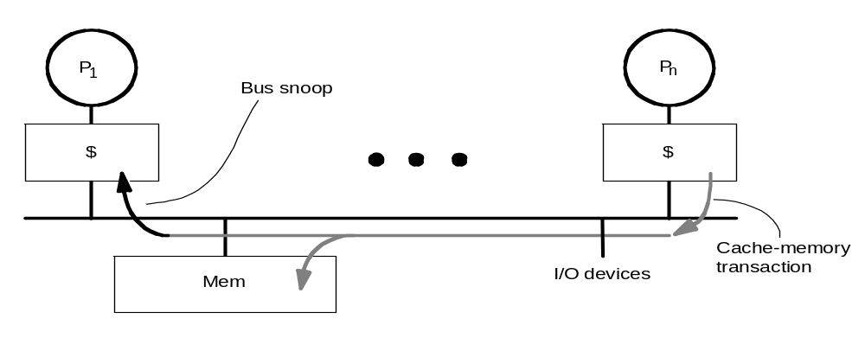
Snooping Cache-Coherence Protocols
State
Address
Data
Cache Controller “snoops” all transactions on the shared medium (bus or switch)
  Relevant transaction if for a block it contains
  Take action to ensure coherence
    invalidate, update, or supply value
  Action depends on state of the block and the protocol
Either get exclusive access before write via write invalidate or update all copies on write

Slide 21
Example: Write-thru Invalidate
P
1
P
2
P
3
u
= ?
u
= ?
3
$
4
$
5
$
u
:5
u
:5
u
= 7
1
I/O devices
u
:5
2
u = 7
Memory
Must invalidate before step 3
Alternative to invalidate?
  update value of u in P1’s cache
  Most efficient approach depends upon data sharing pattern

Slide 22
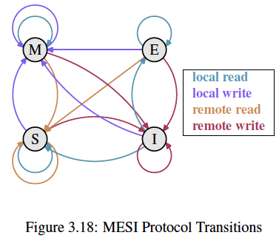
Snoop Protocol
Snooping protocol implemented as a finite-state machine
  Separate FSM associated with each cache block
“modified”
ie, must write back
to memory before
discarding from
cache
“exclusive”
ie, owns permission to write
“shared”
ie, must get
permission to write
Starts off here
“invalid”

Slide 23
Coherence State Machine
(what and where is the state machine?)
Write-through invalidate snoop protocol
Write-back invalidate snoop protocol
Valid Tag Data
Valid Dirty Tag Data
PrRd/ --
PrWr / BusWr
I
S
V
1
1
1
PrRd / BusRd
BusWr / -
I
E
PrWr / BusWr
Direct mapped, write-through, no-write allocate
Valid | State
0 | Invalid
1 | Valid
Direct mapped, write-back, write allocate
Valid | Dirty | State
0 | X | Invalid
1 | 0 | Shared
1 | 1 | Exclusive
One possible encoding

Slide 24
Write-through Invalidate Snoop Protocol
PrRd/ --
PrWr / BusWr
Two states per block in each cache
  I.e., same as in uniprocessor
  Hardware state bits are associated with each blocks that is in the cache
  Blocks not in cache can be seen as being in invalid (not-present) state in cache
Writes invalidate all other cache copies (in other processor caches)
  can have multiple simultaneous readers of block but a subsequent write invalidates them
V
BusWr / -
PrRd / BusRd
I
PrWr / BusWr
State Tag Data
State Tag Data
P
P
n
1
PrRd: Processor Read
PrWr: Processor Write
BusRd: Bus Read
BusWr: Bus Write
$
$
Bus
Mem
I/O devices

Slide 25
Write Back Invalidate Snoop Protocol
Each memory block is in one state (state is implicit)
  Clean in all caches and up-to-date in memory (Shared)
  OR Dirty in exactly one cache (Modified)
  OR Not in any caches
Each cache block is in one state (state is explicit):
  Shared : block can be read
  OR Modified: cache has only copy, its writeable, and dirty
  OR Invalid : block contains stale data or never accessed
Read misses: cause all caches to snoop bus in case they have a modified copy of data (memory may be out of date)
Write hits to “shared” blocks: treated as misses since we need to tell other processor caches about the write so they can invalidate any shared copy of the data.

Slide 26
Writes need to know whether any other copies of the block is cached
Write hit:
  Block in modified state ⇒ No other copies ⇒ No need to place invalidate on bus for writeback cache
  Block in shared state ⇒ may be copies ⇒ Need to place invalidate on bus (will cause other processors to invalidate their copy)
  Write miss:
  Block in invalid state ⇒ write miss ⇒ Need to read block from memory (as in uniprocessor case) or another processor (if modified state in that other processor’s cache).

Slide 27
P
P
n
1
◆
$
$
❖
Bus
Mem
Cache can be accessed by CPU () or Bus ().
We will consider effect of each starting with CPU.

Slide 28
Write-Back State Machine – CPU
CPU Read hit
State machine
for CPU requests
for each
cache block
Non-resident blocks invalid
CPU Read
Invalid
Shared
Place read miss
on bus
CPU Write
Place Write
Miss on bus
CPU Write
Place Write Miss on Bus
Cache Block
State
Starting from “Invalid” which state is next after CPU read?
A: Invalid
B: Shared
C: Modified
D: Not sure
Starting from “Invalid” which state is next after CPU write?
A: Invalid
B: Shared
C: Modified
D: Not sure
Starting from “Shared” which state is next after CPU write?
A: Invalid
B: Shared
C: Modified
D: Not sure
Starting from “Invalid” which state is next after CPU write?
A: Invalid
B: Shared
C: Modified 
D: Not sure
Starting from “Invalid” which state is next after CPU read?
A: Invalid
B: Shared 
C: Modified
D: Not sure
Starting from “Shared” which state is next after CPU write?
A: Invalid
B: Shared
C: Modified
D: Not sure
CPU read hit
CPU write hit
Modified
Notes:
Invalid:
read => shared
write => dirty
shared looks the same

Slide 29
Block-replacement
State machine
for CPU requests
for each
cache block
Shared
(read/only)
Invalid
CPU read miss
Write back block,
Place read miss
on bus
CPU Read miss
Place read miss
on bus
Starting from “Modified” which state do we end up in after a CPU write miss?
A: Invalid
B: Shared
C: Modified 
D: Not sure
Starting from “Shared” which state do we end up in after a CPU read miss?
A: Invalid
B: Shared 
C: Exclusive
D: Not sure
Starting from “Shared” which state do we end up in after a CPU read miss?
A: Invalid
B: Shared
C: Modified
D: Not sure
Starting from “Modified” which state do we end up in after a CPU write miss?
A: Invalid
B: Shared
C: Modified
D: Not sure
Starting from “Modified” which state do we end up in after a CPU read miss?
A: Invalid
B: Shared 
C: Modified
D: Not sure
Starting from “Modified” which state do we end up in after a CPU read miss?
A: Invalid
B: Shared
C: Modified
D: Not sure
Cache Block
State
Modified
(read/write)
CPU Write Miss
Write back cache block
Place write miss on bus
Notes:
Invalid:
read => shared
write => dirty
shared looks the same

Slide 30
Write-Back State Machine- Bus request
State machine
for bus requests
for each
cache block
Write miss
for this block
Invalid
Shared
(read/only)
Starting from “Shared” which state do we end up in after a bus write miss?
A: Invalid
B: Shared
C: Modified
D: Not sure
Starting from “Modified” which state do we end up in after a bus write miss?
A: Invalid
B: Shared
C: Modified
D: Not sure
Starting from “Modified” which state do we end up in after a bus read miss?
A: Invalid
B: Shared 
C: Modified
D: Not sure
Starting from “Modified” which state do we end up in after a bus read miss?
A: Invalid
B: Shared
C: Modified
D: Not sure
Starting from “Shared” which state do we end up in after a bus write miss?
A: Invalid 
B: Shared
C: Modified
D: Not sure
Starting from “Modified” which state do we end up in after a bus write miss?
A: Invalid 
B: Shared
C: Modified
D: Not sure
Write miss
for this block
Write Back
Block; (abort
memory access)
Read miss
for this block
Write Back
Block; (abort
memory access)
State Tag Data
State Tag Data
Modified
(read/write)
P
P
n
1
$
Bus
$
Mem
I/O devices

Slide 31
Write-back State Machine (combined)
CPU Read hit
State machine
for CPU requests
for each
cache block and
for bus requests
for each
cache block
Write miss
for this block
CPU Read
Shared
(read/only)
Invalid
Place read miss
on bus
CPU Write
Place Write
Miss on bus
Write miss
for this block
CPU read miss
Write back block,
Place read miss
on bus
CPU Read miss
Place read miss
on bus
Write Back
Block; (abort
memory access)
CPU Write
Place Write Miss on Bus
Read miss
for this block
Write Back
Block; (abort
memory access)
Cache Block
State
Modified
(read/write)
CPU read hit
CPU write hit
CPU Write Miss
Write back cache block
Place write miss on bus
Notes:
Invalid:
read => shared
write => dirty
shared looks the same

Slide 32
Example
P1
P2
P3
P4
 | State | Tag | Data
B0 | I | 100 | 00 | 00
B1 | I | 108 | 00 | 00
B2 | S | 110 | 00 | 01
B3 | M | 118 | 80 | 40
 | State | Tag | Data
B0 | M | 120 | 01 | 31
B1 | M | 128 | 54 | 40
B2 | S | 110 | 00 | 01
B3 | I | 118 | 80 | 00
 | State | Tag | Data
B0 | I | 100 | 00 | 00
B1 | S | 108 | 42 | 00
B2 | I | 110 | DF | FF
B3 | M | 138 | 00 | 28
 | State | Tag | Data
B0 | I | 100 | 00 | 00
B1 | S | 108 | 42 | 00
B2 | M | 130 | 00 | 02
B3 | I | 118 | 00 | 00
What changes following the operation:
P4: read 118
A: P4.B3:(S,118,80 00)
B: P4.B3:(S,118,80 40)
P1.B3:(S,118,80 40)
C: P4.B3:(S,118,80 40)
P1.B3:(S,118,80 40)
M.118:(80 40) 
D: P4.B3:(S,118,80 40)
P1.B3:(I,118,80 40)
M.118:(80 40)
E: Not sure
What changes following the operation:
P4: read 118
A: P4.B3:(S,118,80 00)
B: P4.B3:(S,118,80 40)
P1.B3:(S,118,80 40)
C: P4.B3:(S,118,80 40)
P1.B3:(S,118,80 40)
M.118:(80 40)
D: P4.B3:(S,118,80 40)
P1.B3:(I,118,80 40)
M.118:(80 40)
E: Not sure
What changes following the operation:
P1: read 138
A: P1.B3:(S,138,80 00)
B: P1.B3:(M,138,80 28)
C: P1.B3:(S,138,00 28)
P3.B3:(S,138,00 28)
M.138:(00 28)
D: P1.B3:(S,138,00 28)
P3.B3:(S,138,00 28)
M.118:(80 40)
M.138:(00 28) 
E: Not sure
What changes following the operation:
P1: read 138
A: P1.B3:(S,138,80 00)
B: P1.B3:(M,138,80 28)
C: P1.B3:(S,138,00 28)
P3.B3:(S,138,00 28)
M.138:(00 28)
D: P1.B3:(S,138,00 28)
P3.B3:(S,138,00 28)
M.118:(80 40)
M.138:(00 28)
E: Not sure
What changes following the operation:
P1: read 100
A: P1.B0:(S,100,00 00)
B: P1.B0:(S,100,00 00)
P2.B0:(S,100,00 00)
P3.B0:(S,100,00 00)
P4.B0:(S,100,00 00)
C: P1.B0:(S,100,00 07) 
D: P1.B0:(M,100,00 07)
E: Not sure
00 | 07
42 | 00
00 | 01
80 | 00
00 | 31
54 | 00
00 | 01
00 | 00
00 | 00
What changes following the operation:
P1: read 100
A: P1.B0:(S,100,00 00)
B: P1.B0:(S,100,00 00)
P2.B0:(S,100,00 00)
P3.B0:(S,100,00 00)
P4.B0:(S,100,00 00)
C: P1.B0:(S,100,00 07)
D: P1.B0:(M,100,00 07)
E: Not sure
100
108
110
118
120
128
130
138
140
Bus-based shared-memory system.
Writeback invalidate snoop protocol.
Direct-mapped caches: 4 blocks, each with 2 words (word = 4B). two words separated by dotted line (smaller addresses on the right).
Tag contains the full address (in hex).
Memory
Address Data

Slide 33
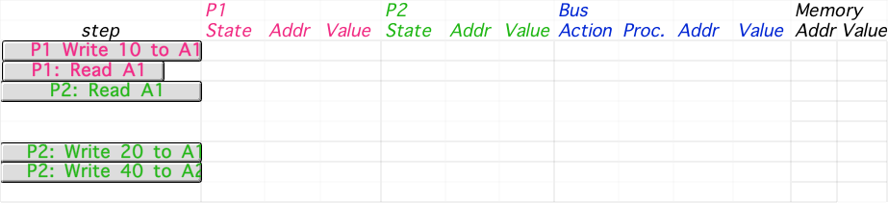
Another Example
Assumes A1 and A2 map to same entry in direct mapped cache,
but different cache blocks (A1 != A2), initial cache state is invalid

Slide 34
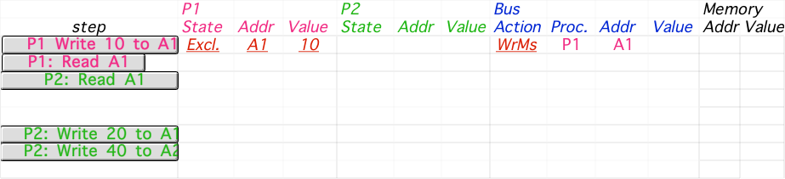
Another Example, continued
Assumes A1 and A2 map to same entry in direct mapped cache,
but different cache blocks (A1 != A2), initial cache state is invalid

Slide 35

Another Example, continued
Assumes A1 and A2 map to same entry in direct mapped cache,
but different cache blocks (A1 != A2), initial cache state is invalid

Slide 36
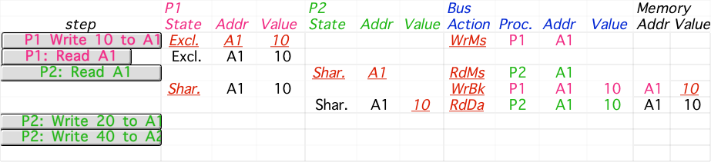
Another Example, continued
Assumes A1 and A2 map to same entry in direct mapped cache,
but different cache blocks (A1 != A2), initial cache state is invalid

Slide 37
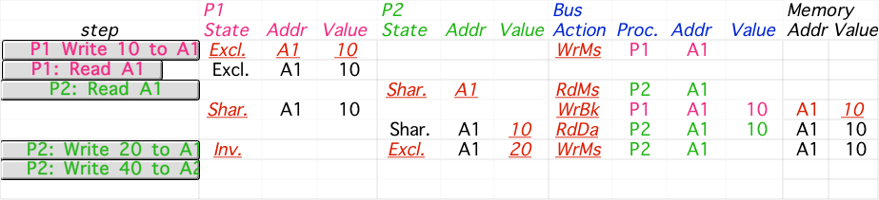
Another Example, continued
Assumes A1 and A2 map to same entry in direct mapped cache,
but different cache blocks (A1 != A2), initial cache state is invalid

Slide 38
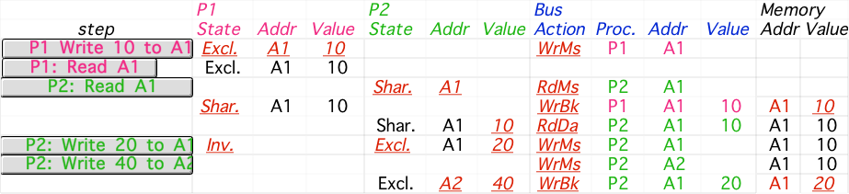
Another Example, continued
Assumes A1 and A2 map to same entry in direct mapped cache,
but different cache blocks (A1 != A2), initial cache state is invalid
Notes:
Why write miss first?
Because in general, only write a piece of block, may need to read it first so that can have a full vblock; therefore, need to get
Write back is low priority event.

